Slide 1
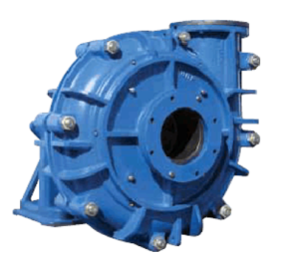
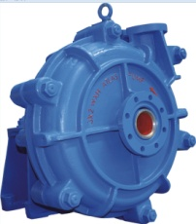
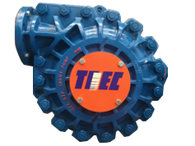
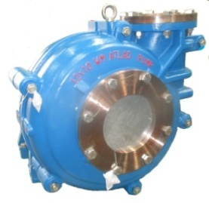

Description
Model | WX | WXH | WXPP | WXF/WLF/ WMF | WM
Dis. size | 1 - 18 inch | 1.5 - 6 inch | 3-18 inch | 2 - 8 inch | 8 -10 inch
Capacity | 5400m³ | 1152m3 | 5400m3 | 10000m3 | 2150m3
Head | 68m | 98m | 68m | 65m | 65m
Application | Mainly used for conveying strong abrasive and high-concentration slurry, suitable for various working conditions, and is the first choice for conveying slurry of mine mills and tailings. | Mainly used to transport strong abrasive slurry, especially suitable for high-concentration and high-lift conditions that cannot be transported by ordinary single-stage pumps. | Mainly used for processing abrasives and corrosive slurry in mining and mineral processing, power plant, refining, coal preparation and other industries. | Specially used for conveying foam and high viscosity slurries in non-ferrous metal extraction. | Mainly used for conveying medium-abrasive, low-concentration slurries, and is suitable for medium and low lift conditions.

Slide 2
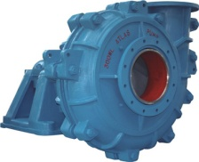
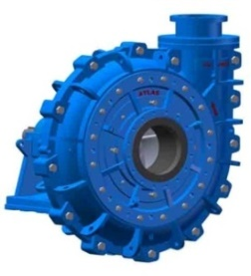
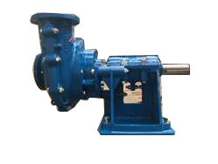
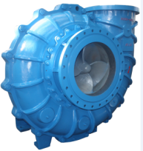
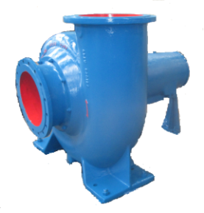
Description
Model | WL(R) | WSA | WSH | WDL | WFS
Dis. size | 20mm-650mm | 6 - 26 inch | 4 - 6 inch | 600mm-800mm | 100mm-400mm
Capacity | 10260m3 | 22000m3 | 10000m3 | 15000m3 | 3500 m3
Head | 63m | 55m | 61m | 42m | 69m
Material | High chromium metal, rubber | High chromium metal, rubber | High chromium metal, rubber, polyurethane | High chromium metal, rubber | Ductile iron, stainless steel
Application | Mainly used for transporting medium abrasive and low-concentration slurries, and it is more economical to handle mild slurries. | Mainly used for conveying strong abrasive and high-concentration slurries. It is the first choice for mine mill slurry and can replace old models. | Mainly used for conveying strong abrasive and high-concentration slurry. | Mainly used for flue gas desulfurization, the pump has a compact structure, which can effectively save installation space. | Mainly used for sewage treatment projects, mine grey water transportation.

Slide 3
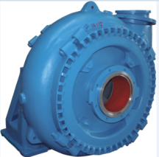
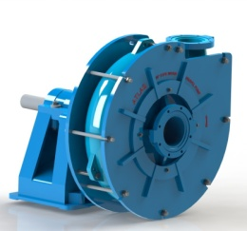
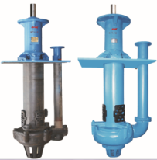
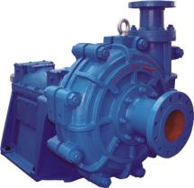
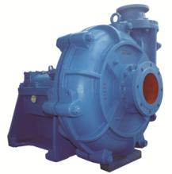
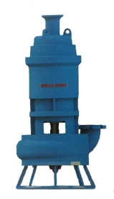
Description
Model | WG(H) | WGHB/WGHP | VC/VCH | SPH | SPL | SPS
Dis. size | 4 -14 inch | 8 - 10 inch | 1.5 - 10 inch | 65-400mm | 40-400mm | 80-150mm
Capacity | 5600m3 | 1440m3 | 1089m3 | 1920m3 | 2333m3 | 288m3
Head | 78m | 61m | 38m | 94m | 133.7m | 32m
Material | high chromium metal | high chromium metal | High chromium metal, rubber, polyurethane | High chromium metal | High chromium metal | High chromium metal
Application | Mainly used for handling large particle materials and strong abrasive slurries that cannot be conveyed by ordinary slurry pumps. | Mainly used for dealing with large particle materials and strong abrasive slurry that cannot be conveyed by ordinary slurry pumps, and is mostly used in multi-stage series. | Mainly used for conveying abrasive, coarse particle and high-concentration slurries. It can work normally even when the suction capacity is insufficient. | Mainly used for conveying abrasive or corrosive slurry, especially for conveying power plant ash and slag. It is suitable for large flow and high lift conditions. | Mainly used in coal washing industry, especially filter press feed, power plant ash and slag, suitable for medium slurry concentration, high lift conditions. | Mainly used for processing abrasive and corrosive slurry in mining and beneficiation, power plant, refining, coal preparation.

